Slide 1
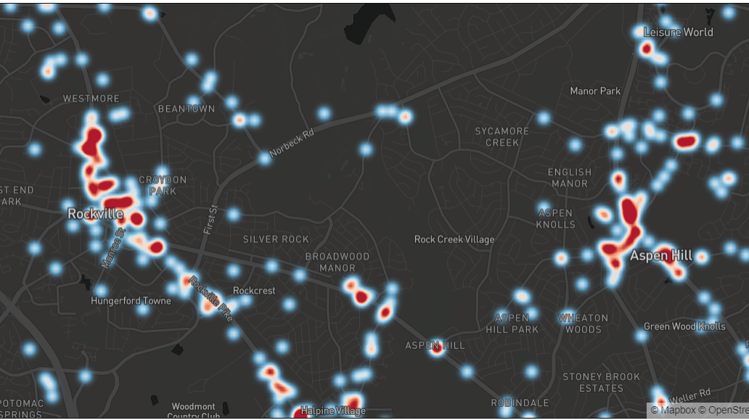

A Review for Traffic Safety in Montgomery County, MD - Vehicle Collisions Data Visualization and Analysis
Yanmin lu
Deliverable 3
Data 606 Fall 2020

Slide 2
Models and Results
Hypothesis:
The selected features would either increase or decrease the odds of injury severity of a vehicle collision
Data:
All fatal crashes plus 3000 random samples of all other types of incidents to train the model
What distracted the responsible driver;
the reason for the accident;
the weather and type of lighting for the day;
vehicle information, angle of impact, and time of the collision.

Slide 3


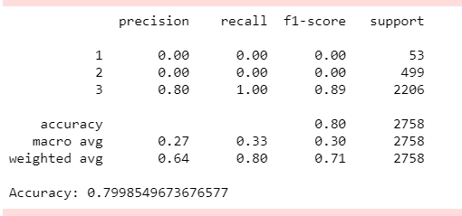
Models and Results
Logistic Regression
Accuracy looks acceptable but misleading

Slide 4
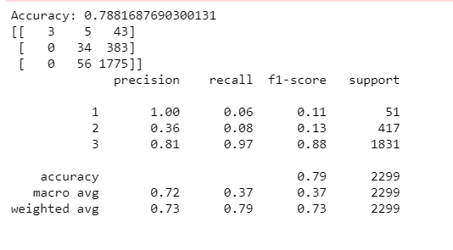
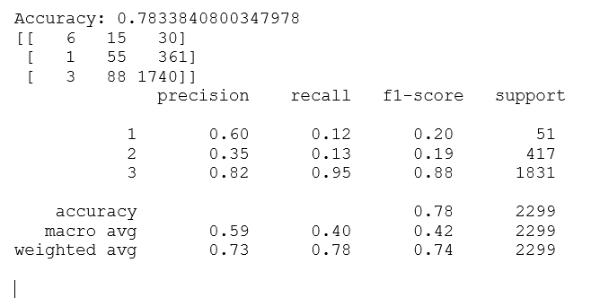
Models and Results
Random Forest
XGBoost

Slide 5

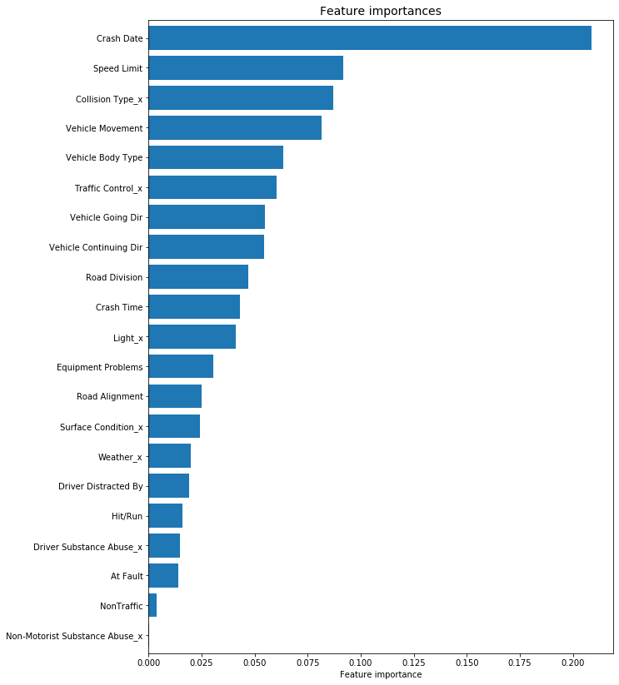


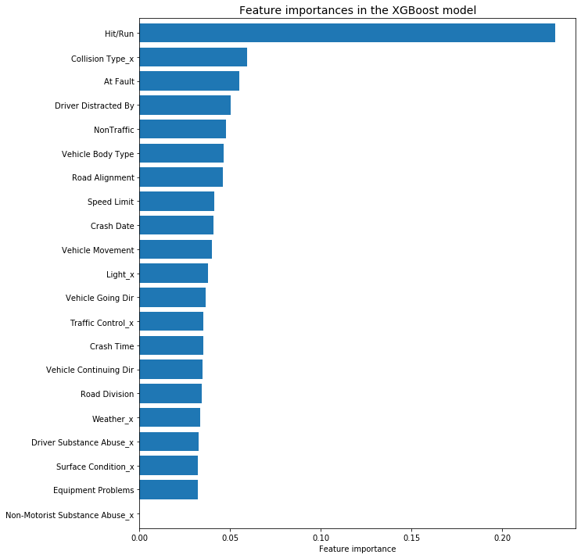

Feature Importance
RDF chooses the “crash date” as the most informative feature overall, gives more weight than crash time.
XGBoost chooses “Hit/Run” as the most informative feature.

Slide 6
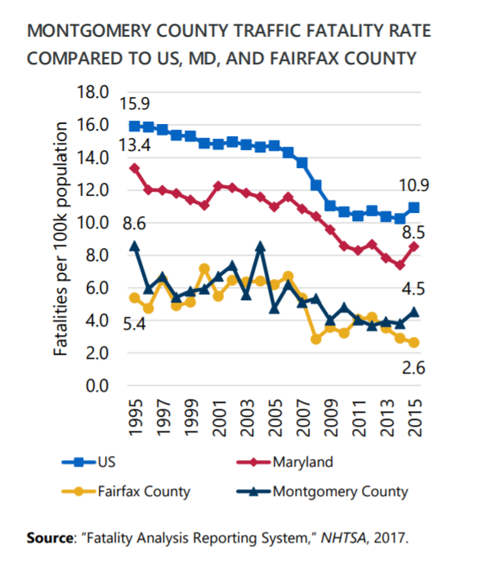
Discussions and Conclusions
It’s hard to find a best performing model in this stage.
Overall, Montgomery county traffic fatality rate is lower than US and Maryland rate.
Fatal accidents are much more likely to occur in dark conditions – more than half fatal crashes occurred from 7:00 p.m. – 7:00 a.m. Weather conditions and road surface conditions have less notable effect on accident severity.
Interestingly, accidents in snowy conditions are less likely to result in fatalities - it make sense because traffic tends to be travelling more slowly and drivers tend to exercise great care in the snow.

Slide 7
Limitation
The dataset does not contain information about responsible drivers
Too few fatalities cause imbalance of data
Data quality issue due to unified standard

Slide 8
What can be done next
Consider to use Maryland dataset to view a whole picture of the State
Consider to use population density data
Using the satellite images from Google's Static Maps API to build a convolutional neural network (CNN)

